Slide 1




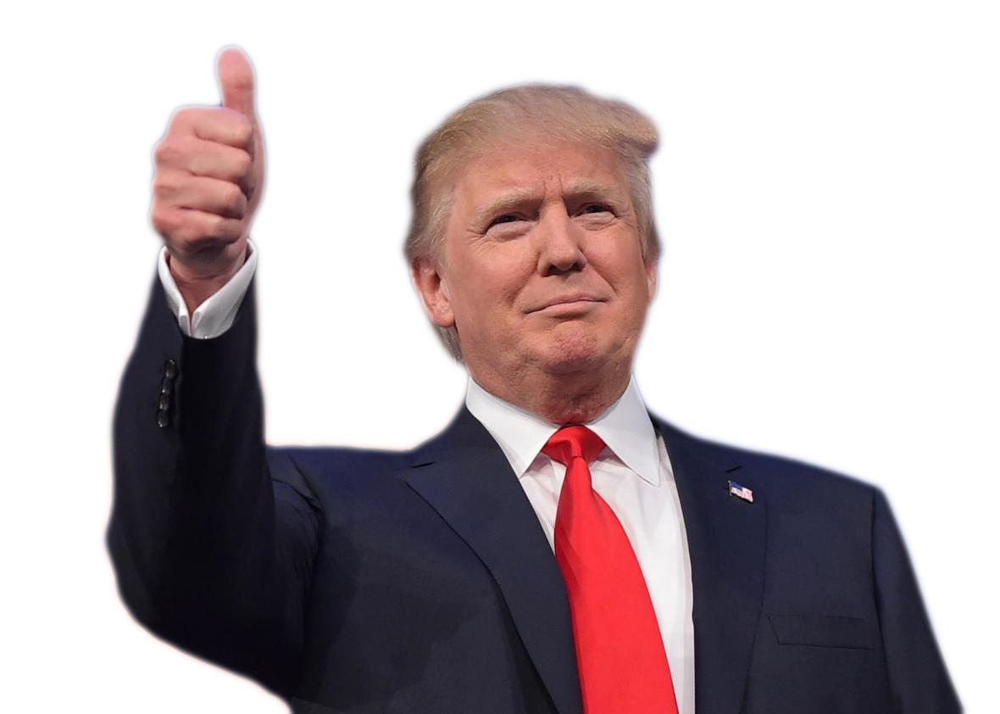

Cambridge Analytica Scandal
Urvaksh Irani, Rahat Mahmud, Mayumi Wakatsu

Slide 2
What is Cambridge Analytica
Cambridge Analytica was founded in 2013 as a subsidiary of a consulting firm called SCL Group in the United Kingdom
It specialized in election consulting, and is particularly good at psychological analysis based on behavioral historical data from social media
It had publicized that it can perform detailed analysis (micro-targeting) on potential voters based on the data collected

Slide 3
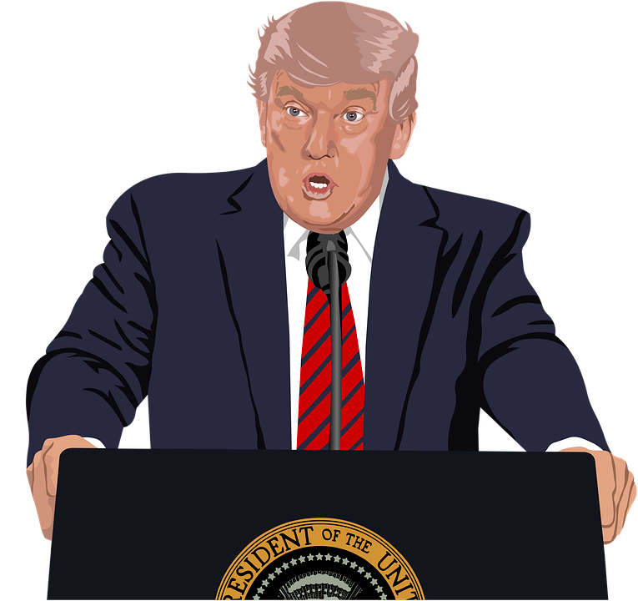
The Incident
Cambridge Analytica has been accused of using illegally collected personal data from voters to manipulate the results for:
Brexit in the UK referendum
US Elections (Trump Campaign)
Millions of Facebook profiles were harvested by Aleksandr Kogan for Cambridge Analytica which were later accessed in Russia

Slide 4
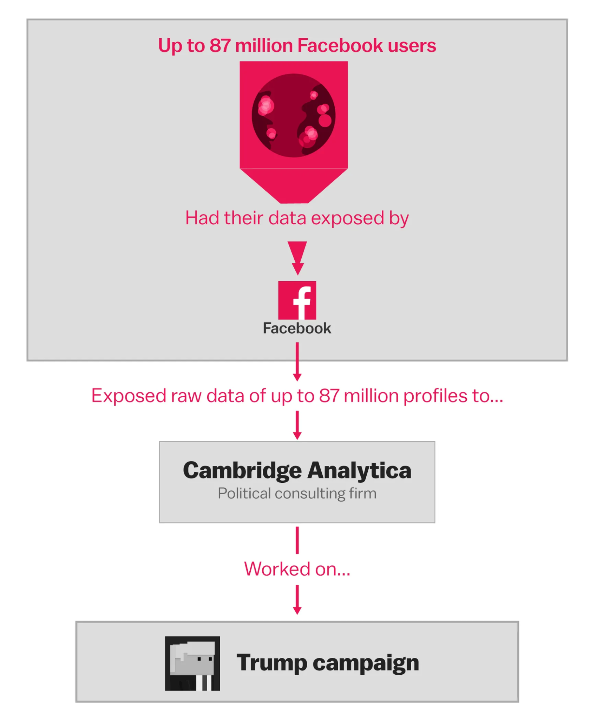
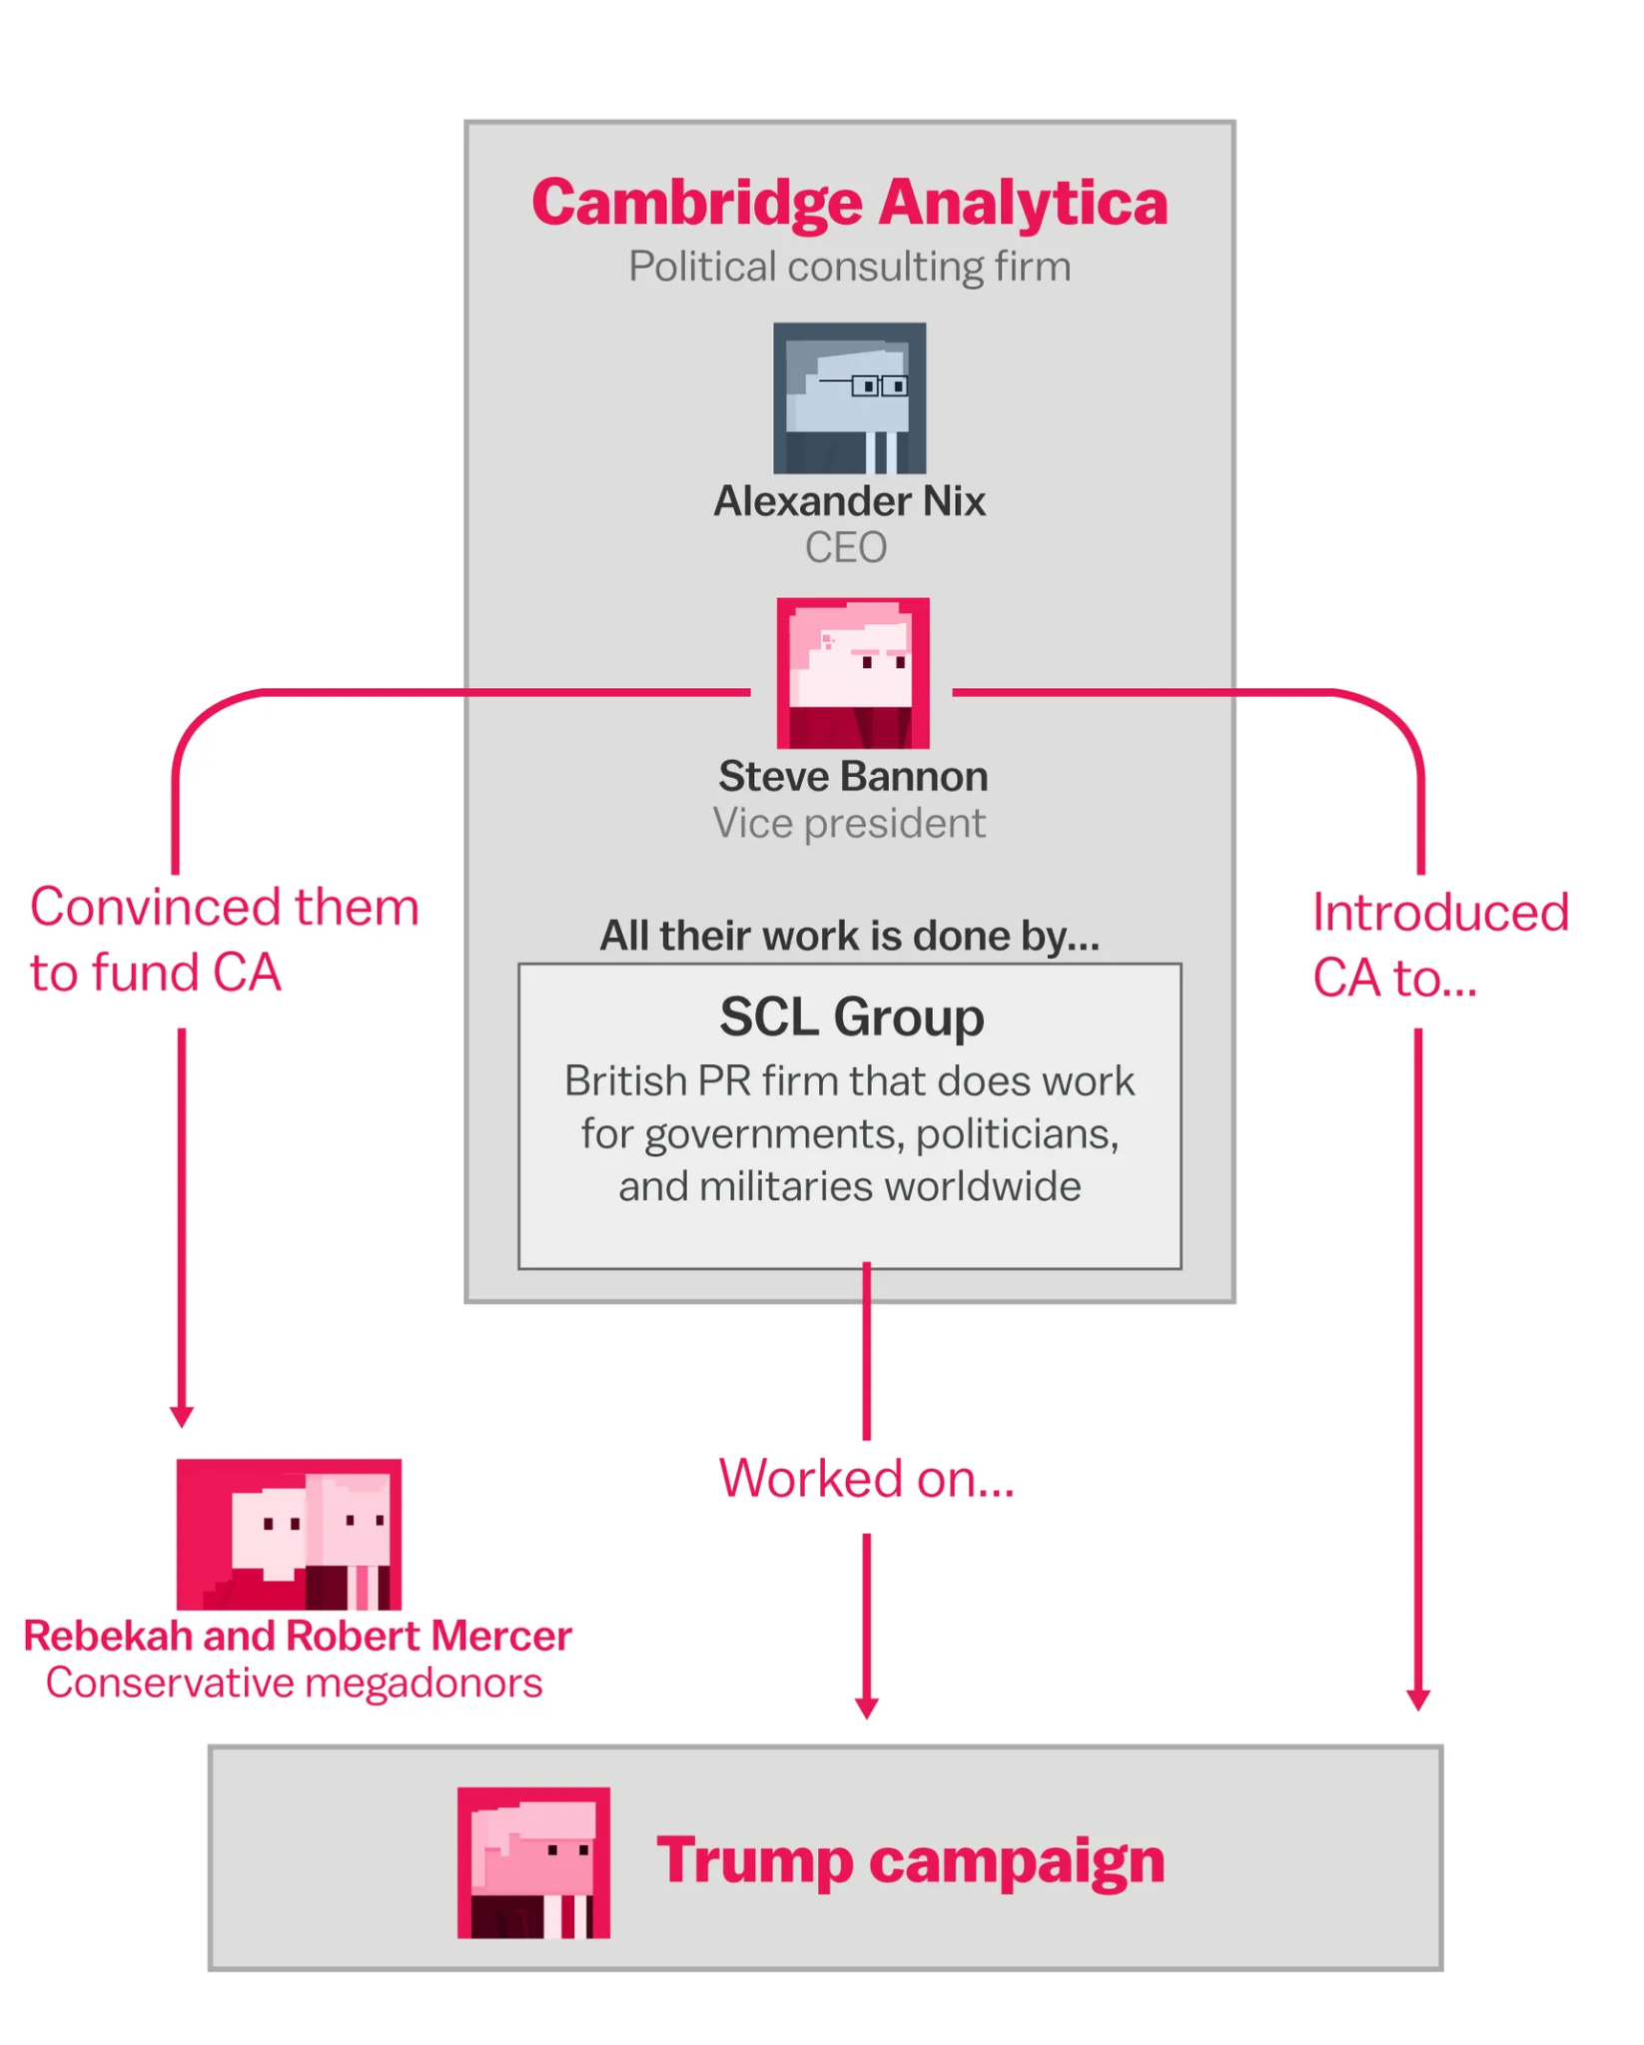
Election

Slide 5
Advent Cambridge Analytica
Cambridge Analytica obtained data via University of Cambridge researcher Aleksandr Kogan, a Russian American
Aleksandr Kogan built a Facebook app that quizzed people
In addition to user data, their friends data was also collected. As a result, it became a "psychological operation" using personal data
It accessed data of up to 87 million Facebook users

Slide 6
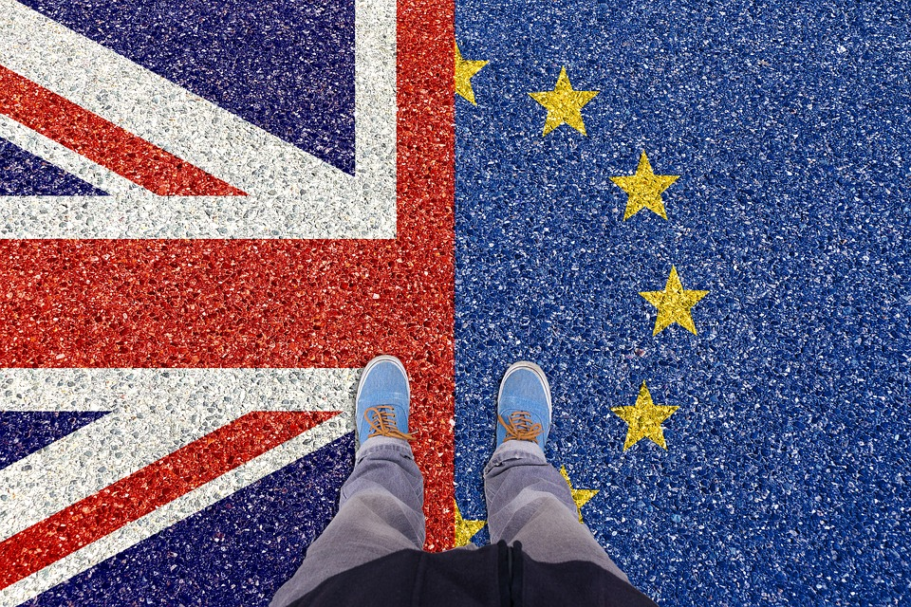
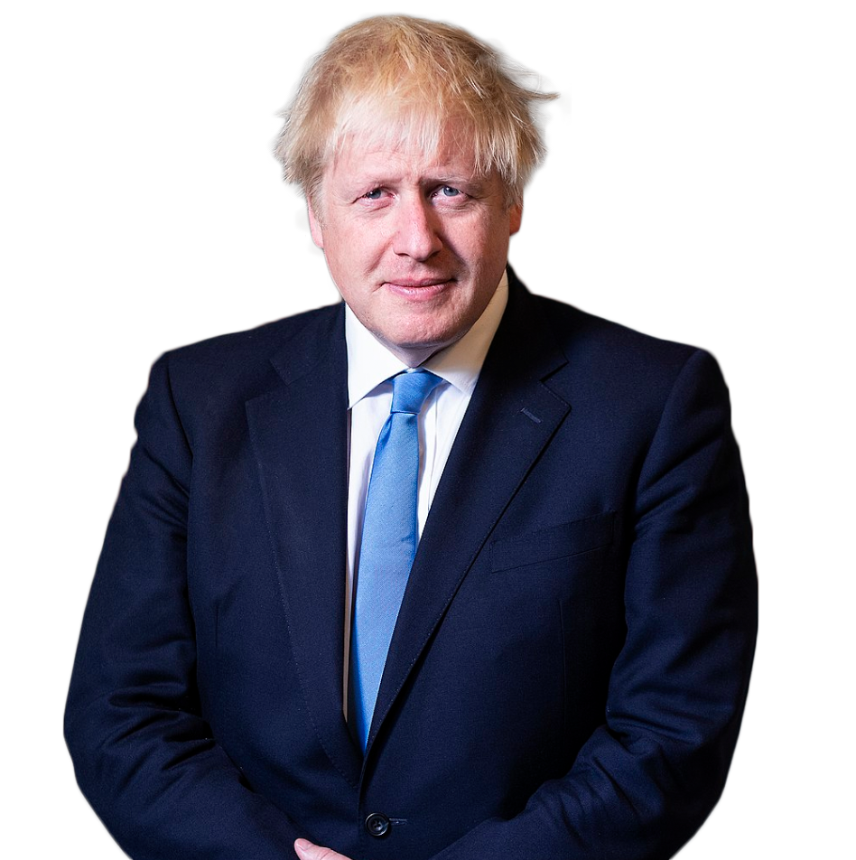
Brexit
Vote Leave Campaign
Vote Leave is a campaigning organisation that supported a "Leave" vote in the 2016 United Kingdom European Union membership referendum
Boris Johnson the current Prime Minister of United Kingdom was a prominent figure in this Campaign

Slide 7

Claims made by Christopher Wylie
(Former employee at Cambridge Analytica)
Vote Leave worked with Cambridge Analytica via a back door – through a company called Aggregate IQ, which had handled the online side of its campaign
The Data Science part of this project was conducted by a different firm called ASI Data
This theory lacked evidence and therefore was dismissed

Slide 8
AGGREGATE IQ
The company says it is in the business of online advertising and software development but it actually makes digital tools for political campaigns
According to Wylie:
Aggregate IQ was set up to do work for a company called SCL, the parent company of Cambridge Analytica
It developed software that relied on algorithms Cambridge Analytica had developed using the 50 million user profiles harvested in 2014
It then used those algorithms for its client’s political campaigns to tailor the ads people saw

Slide 9
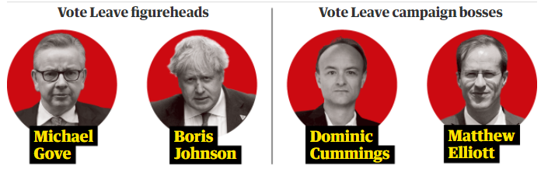



VOTE LEAVE CAMPAIGN
Parent Company
Conducted preliminary work for LEAVE.EU - Vote Leave’s rival organization
£2.7m
SCL Elections
Spent with AIQ (40% of campaign spending)
Low profile company in UK
Canadian Data Company
Company in UK

Slide 10
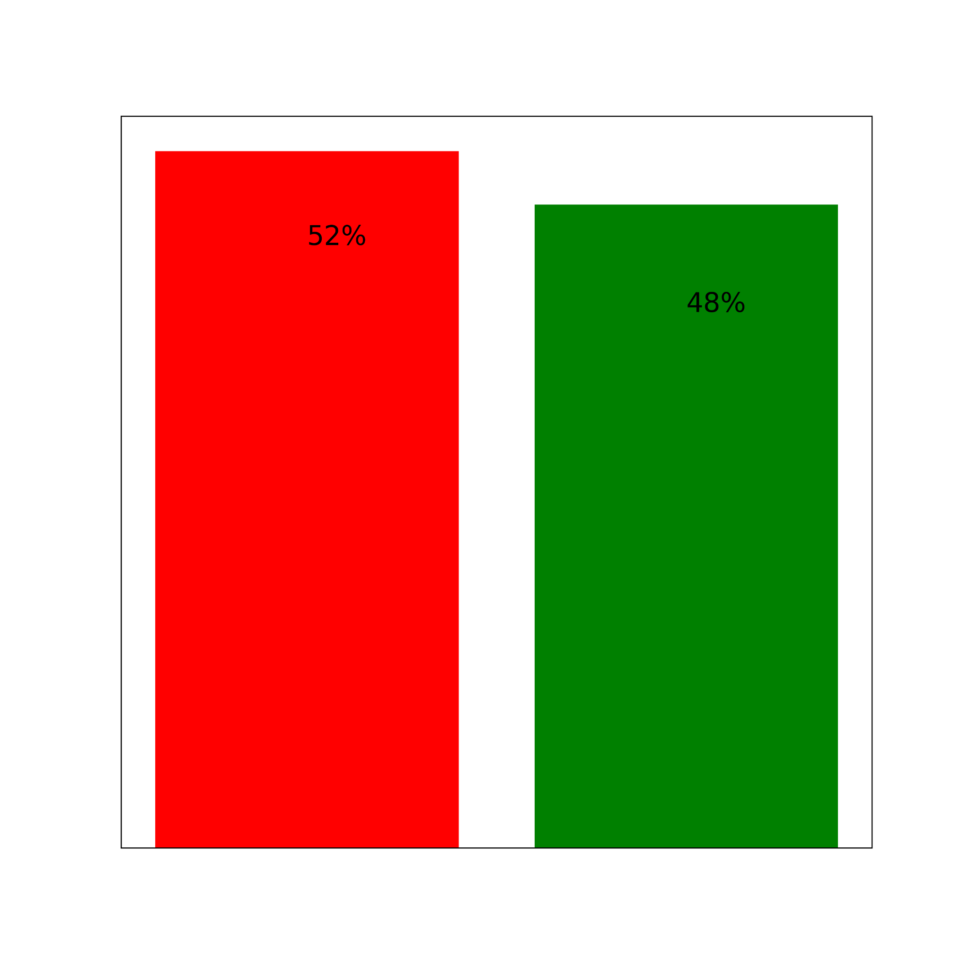
End Result
The difference of 4% was equivalent to 1.3 million votes. Therefore, spending £500,000 extra on online adverts had proven decisive
Regulatory bodies did not find any link between Cambridge Analytica and Brexit
The Information Commissioner, Elizabeth Denham spent three years investigating the role of Cambridge Analytica and analyzed 42,700 terabytes of data, 31 servers, and more than 300,000 documents but couldn’t determine a connection

Slide 11
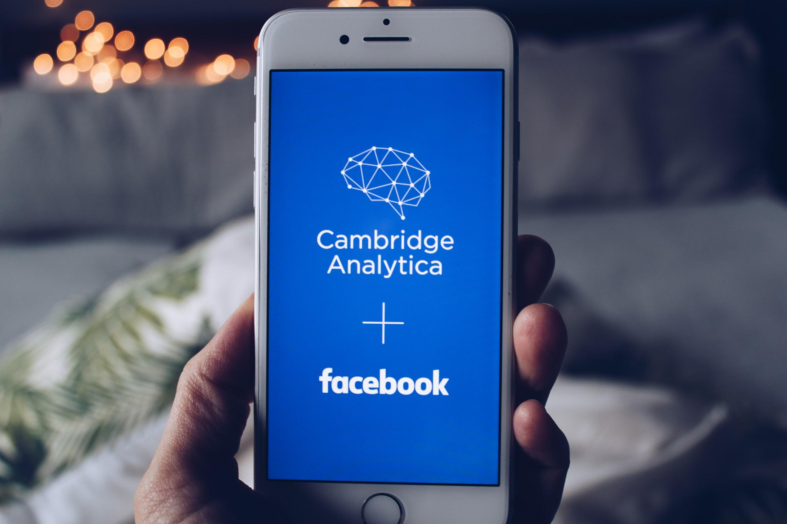
Russian connection
●Journalist Shane Harris offered some compelling evidence that suggested Russian hackers’ involvement in Trump’s campaign
●Harris interviewed Peter Smith, a pro-Trump GOP operative who was reportedly seeking Hillary Clinton’s email
●Peter Smith was in close contact with Michael Flynn

Slide 12
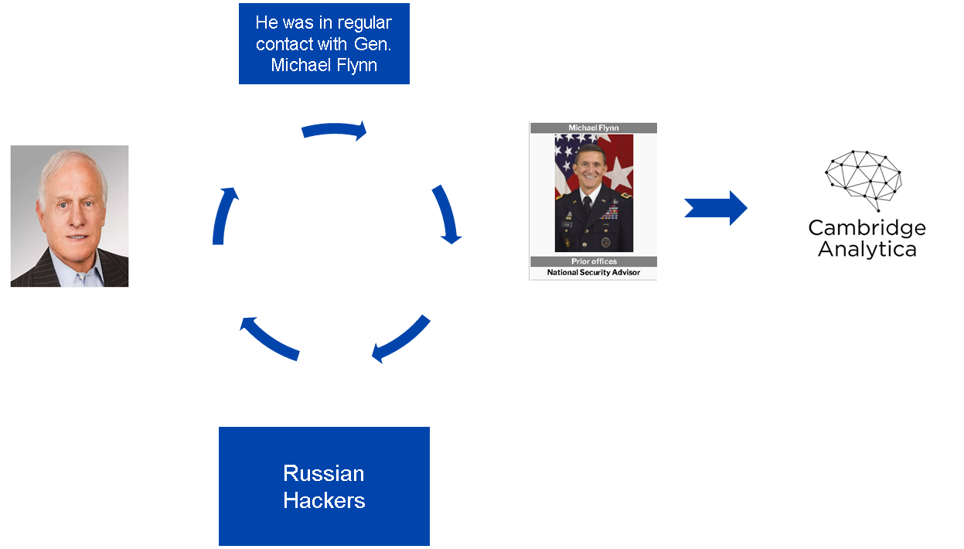

Slide 13
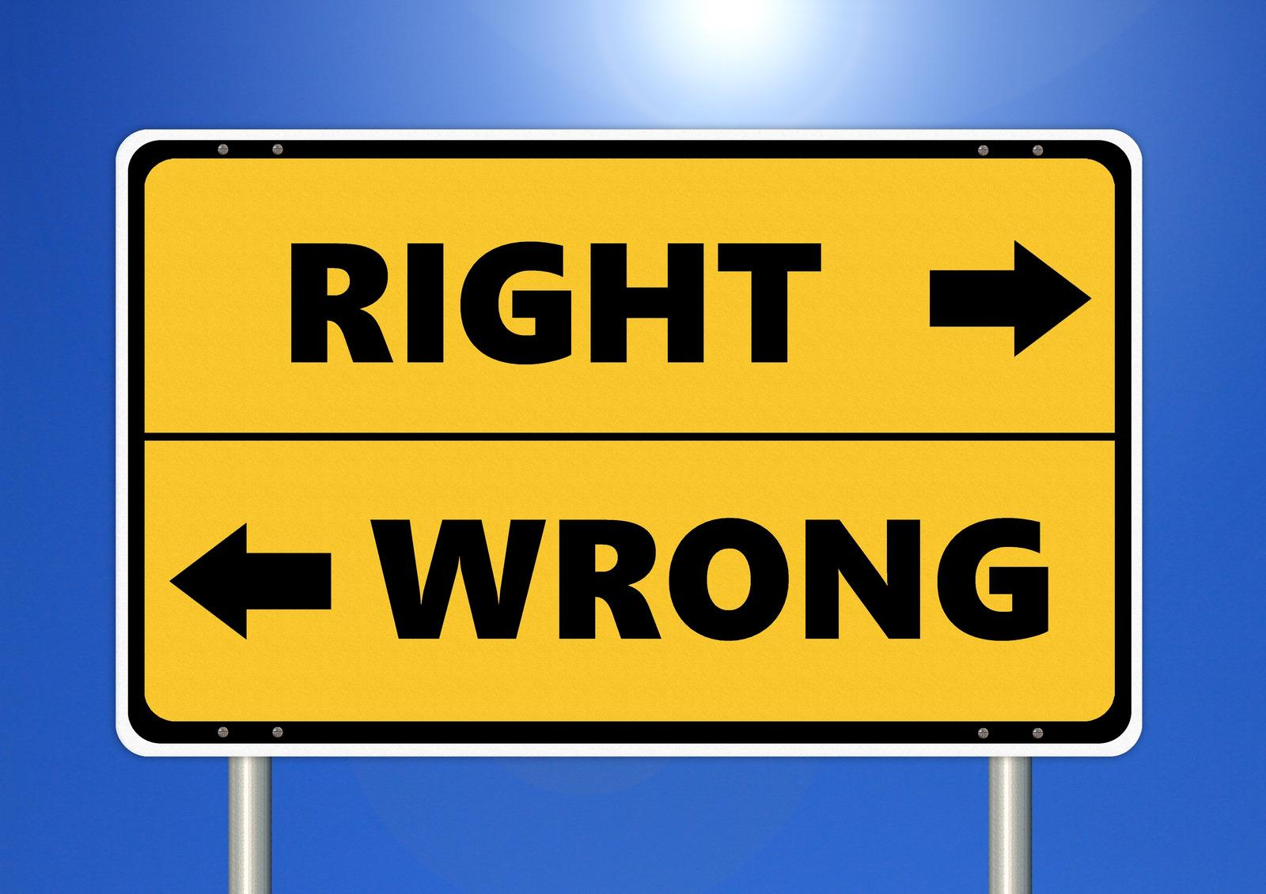
Ethics Violation
Lack of transparency
Acquired data through surveys & didn’t mention the use of such data to the people
Violation of Privacy
C.A also acquired and used data of their friends which is a violation of privacy and consent
Biased Algorithm
Used those data to manipulate people by providing them with content that indirectly forced them to change their perspectives

Slide 14
Bibliography
Ball, J. (2020, October 11). The real story of Cambridge Analytica and Brexit. The Spectator. Retrieved March 14, 2022, from https://www.spectator.co.uk/article/were-there-any-links-between-cambridge-analytica-russia-and-brexit-
Bertrand, N. (2019, April 20). 5 unresolved mysteries about Russian meddling in Mueller’s report. POLITICO. https://www.politico.eu/article/five-unresolved-mysteries-russian-meddling-mueller-report/
Braga, M. (2018, March 28). Everything you need to know about aggregateiq, the Canadian tech company with ties to Brexit and Ted Cruz | CBC news. CBCnews. Retrieved March 14, 2022, from https://www.cbc.ca/news/science/aggregateiq-brexit-ted-cruz-aiq-scl-cambridge-analytica-1.4596292
Cambridge Analytica’s Facebook data was accessed in Russia. (2018, July 18). Business Insider. https://www.businessinsider.com/cambridge-analytica-facebook-data-accessed-in-russia-2018-7?international=true&r=US&IR=T
Chang, A. (2018, March 23). The Facebook and Cambridge Analytica scandal, explained with a simple diagram. Vox. Retrieved March 13, 2022, from https://www.vox.com/policy-and-politics/2018/3/23/17151916/facebook-cambridge-analytica-trump-diagram
Hamilton, I. A. (2018, July 18). Cambridge Analytica's Facebook data was accessed in Russia. Business Insider. Retrieved March 12, 2022, from https://www.businessinsider.com/cambridge-analytica-facebook-data-accessed-in-russia-2018-7
Illing, S. (2018, April 4). Cambridge Analytica, the shady data firm that might be a key Trump-Russia link, explained. Vox. https://www.vox.com/policy-and-politics/2017/10/16/15657512/cambridge-analytica-facebook-alexander-nix-christopher-wylie
Mak, T. (2018, March 22). Cambridge Analytica scandal raises new ethical questions about microtargeting. NPR. Retrieved March 13, 2022, from https://www.npr.org/2018/03/22/596180048/cambridge-analytica-scandal-raises-new-ethical-questions-about-microtargeting
Martin, D. (2018). What role did Cambridge Analytica play in the Brexit Vote?: DW: 27.03.2018. DW.COM. Retrieved March 14, 2022, from https://www.dw.com/en/what-role-did-cambridge-analytica-play-in-the-brexit-vote/a-43151460
Scott, M. (2019, July 31). Cambridge Analytica did work for Brexit groups, says ex-staffer. POLITICO. Retrieved March 14, 2022, from https://www.politico.eu/article/cambridge-analytica-leave-eu-ukip-brexit-facebook/
Waterson, J. (2020, October 7). Cambridge Analytica did not misuse data in EU referendum, says watchdog. The Guardian. Retrieved March 14, 2022, from https://www.theguardian.com/uk-news/2020/oct/07/cambridge-analytica-did-not-misuse-data-in-eu-referendum-says-watchdog

